Slide 1
Important Features of a Map

Slide 2
Features on a Map
Map title
Compass
Legend
Longitudinal lines
Latitudinal lines
Scale

Slide 3
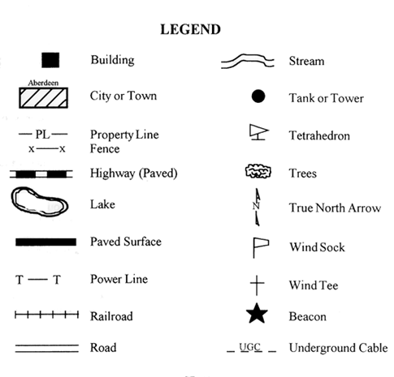
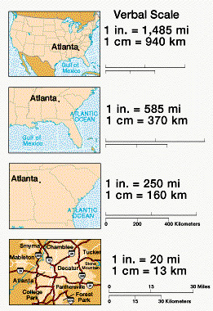
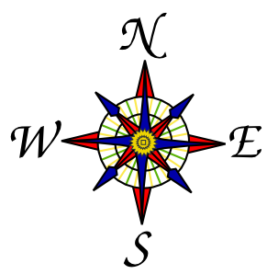
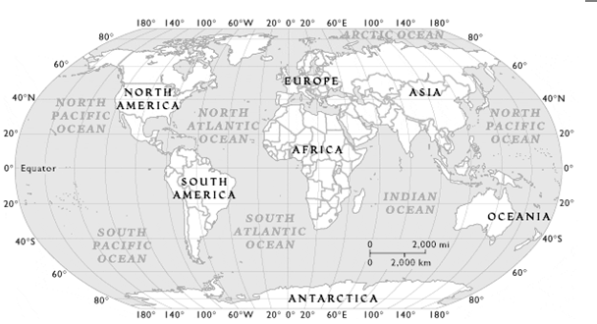
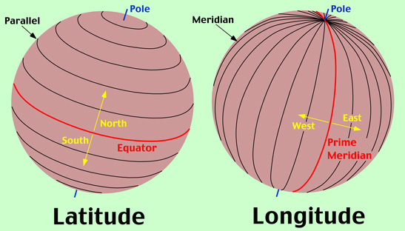

Slide 4
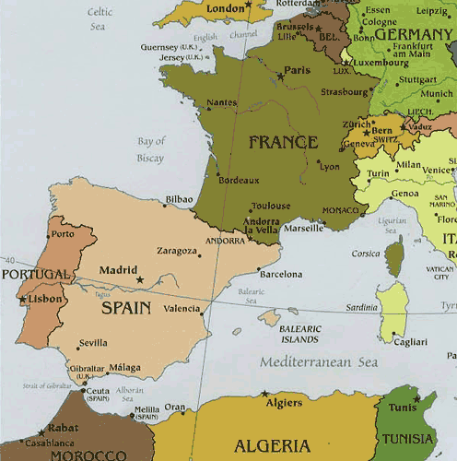
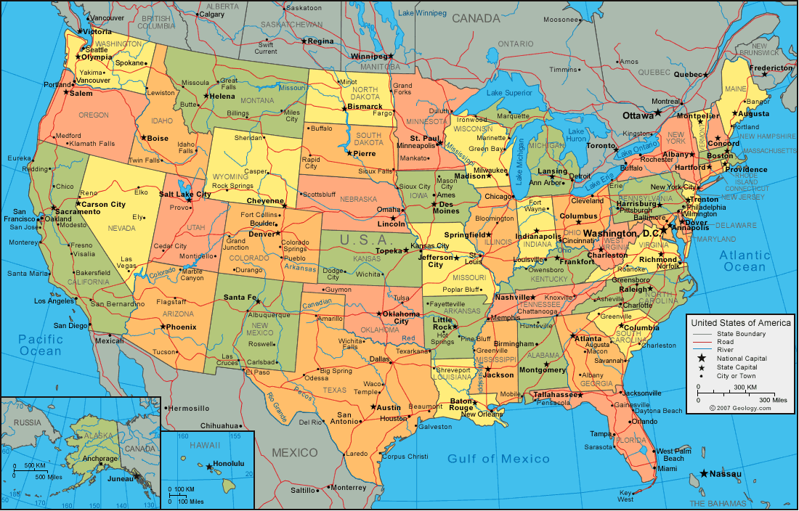
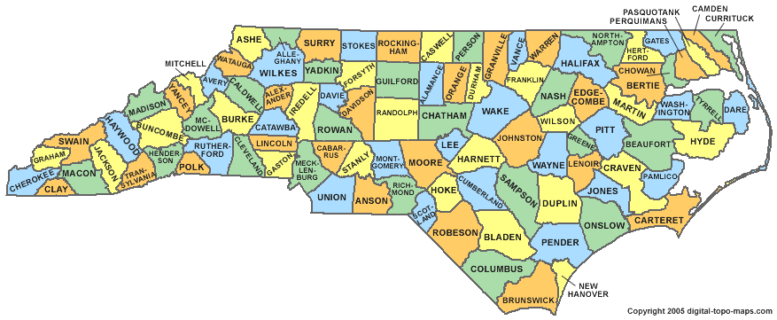
Types of Maps
Political Map:
A political map focuses solely on the state and national boundaries of a place. They also include the locations of cities - both large and small, depending on the detail of the map.

Slide 5
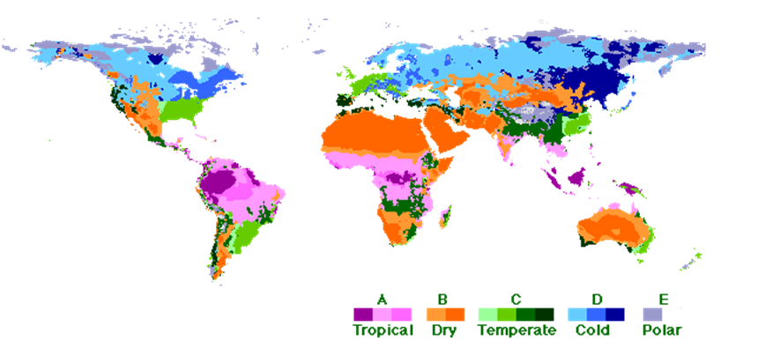
Types of Maps
Climate Map:
A climate map shows information about the climate of an area. They can show things like the specific climatic zones of an area based on the temperature, the amount of snow an area receives or average number of cloudy days. These maps normally use colors to show different climatic areas.

Slide 6
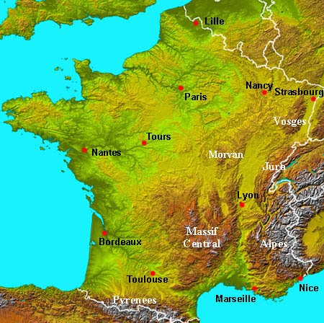
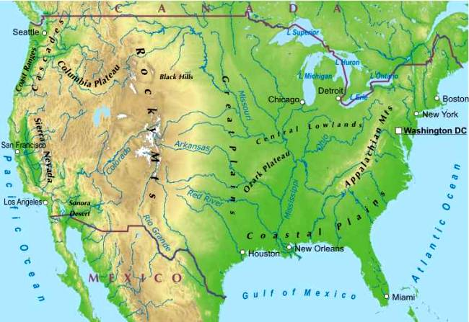
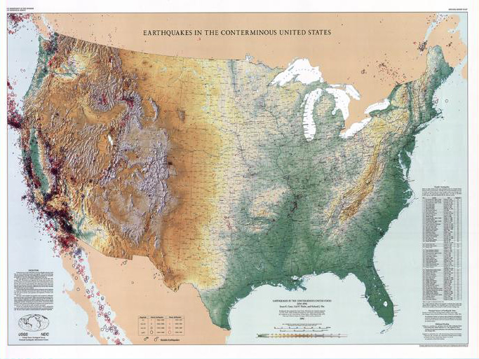
Types of Maps
Physical Map:
A physical map is one that shows the physical landscape features of a place. They generally show things like mountains, rivers and lakes and water is always shown with blue. Mountains and elevation changes are usually shown with different colors and shades to show relief. Normally on physical maps green shows lower elevations while browns show high elevations.

Slide 7
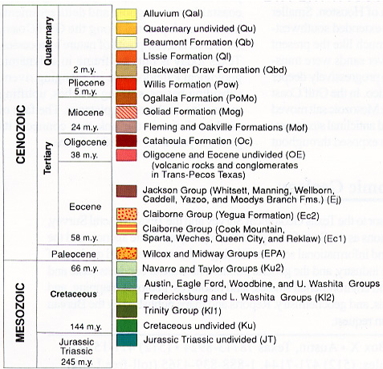
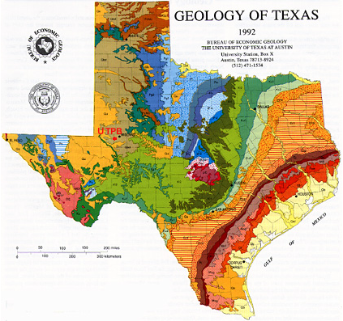
Types of Maps
Economic or Resource Map:
An economic or resource map shows the specific type of economic activity or natural resources present in an area through the use of different symbols or colors depending on what is being shown on the map.

Slide 8
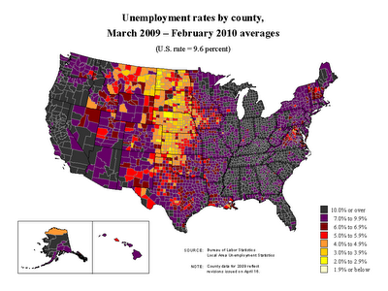
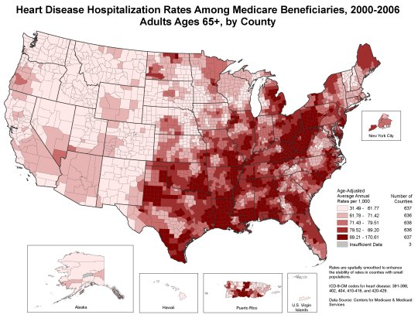
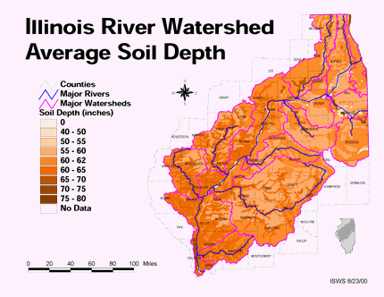
Types of Maps
Thematic Map:
A thematic map is a map that focuses on a particular theme or special topic. Thematic maps may illustrate a change population, unemployment rates, or environmental themes.

Slide 9
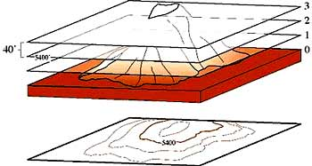
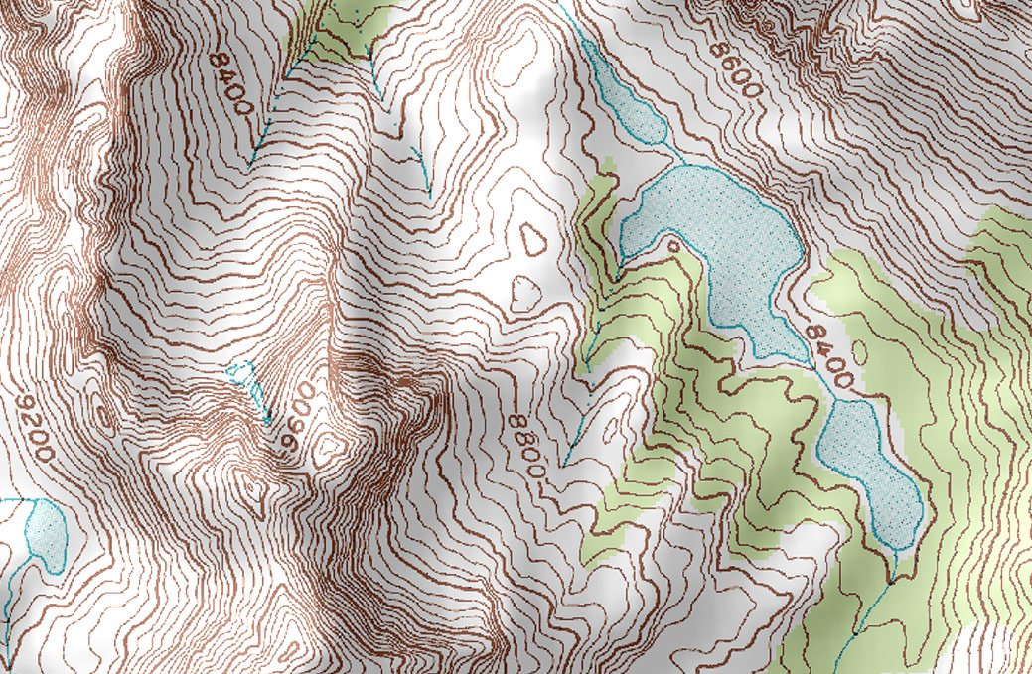
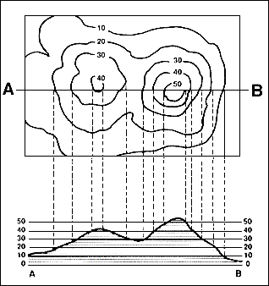
Types of Maps
Topographic Map:
A topographic shows different physical landscape features with the use of contour lines. The lines on topographic maps are normally spaced at regular intervals to show elevation changes (e.g. each line represents a 100 foot (30 m) elevation change) and when lines are close together the terrain is steep.

Slide 10
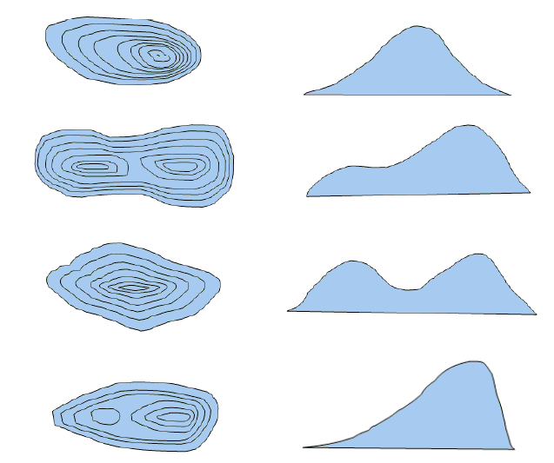
Topographic Matching

